Slide 2
Impact of Poor Site Performance on Dollar Value
Mu-Sigma enabled a large retailer to capture an additional revenue of 14% by helping it to improve its Website Performance
Background
Insights/Recommendations
Mu-Sigma found a clear decreasing trend in conversion rate with an increase in Page load time
The client is one of the largest retailer in the world and has a global presence in almost 14 countries
The online subsidiary is among the top 5 e-commerce players in the world
The client is ranked #11 among the top retail players in terms of site performance with page response time 3 seconds more than the chart leader.(http://www.gomez.com/us-retail-web-mobile-site-performance-index)
The client wants to determine the impact of poor site performance on the dollar value generated by the website.
The engineering team at client was recommended to optimize the various pages based on page category, browser, OS, etc, to boost the site performance
Analytical Approach
Mu Sigma Problem DNA was leveraged to create template for analyzing impact of site performance on dollar revenue
Exploratory Data Analysis was done to identify factors like Page Category , Browser/OS type ,Internal Site Search, etc which were resulting in the poor site performance
Keeping a benchmark of 3s (top industry performer), the dollar loss was computed
Business Impact
Mu-Sigma identified an opportunity for the client to capture an additional 14% sales by improving site performance to match that of the top player
Back

Slide 3
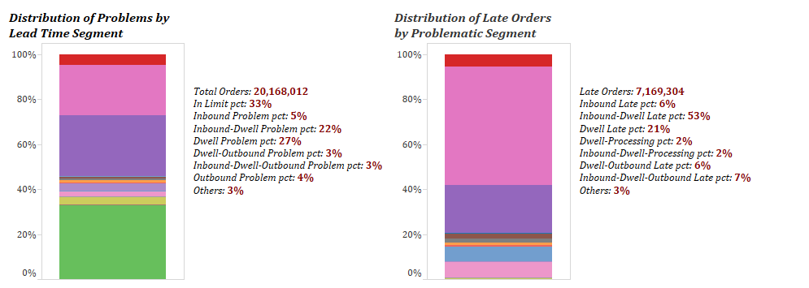
Mu Sigma helped a retailer to reduce missed/lost sales by identifying the segment where orders were being late
Supplier assessment
Background & Objectives
Approach
Because of orders being late when they arrive at the stores, stores were losing revenue due to out of stock scenarios
The business statement was to determine the lead time segment which was leading to the most number of late orders and take corrective measures in that segment (reduce the lead time by 1 day)
Lead Time is broken down into four segments – inbound (supplier to DC), yard dwell, DC processing, and outbound (DC to store)
Lead Time metrics were computed for a one year time period for one DC
For that DC, all orders in that respective time period was collected and late orders were identified by rigorous exploratory data analysis
Lead time metrics were averaged at an Item-Store level and the delays were calculated to identify the late order contributing segments
Each late order was mapped to a segment which caused it to become late, identifying the segment contributing to most of the late orders. The data was displayed in a tableau dashboard
Output

Slide 4
Mu Sigma in partnership with the Product Intelligence team identified drivers of churn and recommended solutions to counter it
New User Churn Analysis
Business problem
Insights
Product Intelligence team of a collaboration platform is responsible for driving the share of active users on the product
~55% of the new users churn from the product by the end of their first month
The team wants to identify the various factors resulting in churn of new users in their first month on the product
There were 4 features that we found had statistically significant impact on customer stickiness to the product:
Users need to be part of min 3 teams (collaboration improves retention)
Big rollout in large tenants results in the lower churn rates
Mobile usage was paramount to customer’s continued usage of the product
Usage of 1:1 chat messages ensured stickiness
Considering the factor list built around the user behavior, exploratory data analysis (EDA) and modelling was done in four steps:
Single factor analysis-Part 1: Calculating effect of each factor on dark rates and the action completion on the 1st day vs. 1st week on the app
Single factor analysis- Part 2: Reporting the effect of completing the action(factor) in different weekly stages in the first month
Two Factor analysis: Reporting all the 2-factor combinations against the churn rates
Decision tree modelling to identify the top combination of factors that result in churn
Approach
Recommended Solutions
There are product change and marketing solutions that we proposed which are currently in the implementation/design phase
Change first run experience to land users to chat thread
Nudge users to join a Team with suggestions based on their interactions/organization they belong to
Mobile upsell program
Sales & Marketing given the directive to do large scale rollouts

Slide 5
Reporting

Slide 6

Mu Sigma optimized assortment operations for a large Grocery Retailer and saved 1800 of man hours per week
Problem and solution overview
Situation
Methodology
The Buyer’s team receive and collate multiple business reports to understand what is the performance of their buying area.
Effort in getting the finding by collating the reports is way high than creating insights
No view on impact of decisions at multiple business levels
Scenario Planner (impact on delisting and introducing NPD)
Generate Forecast for multiple time period (13,26 &52wks)
Reporting Module (Dashboard)
UI development
Aggregated data at Weekly level
Data Cleaning
Automated Integrated Data
Complication
Creating Single source of truth was challenging as there were multiple data platforms and PoCs
Creating one generic UI with important business metrics
The current way of creating insights has multiple issues – multiple business reports, category specific key KPIs, validation of data source
Outcome
Key Questions
Mu Sigma built a tool which incorporates Reporting, Ranging and Pricing module that caters multiple buyer’s need
The Buyer’s team can monitor growth and identify anomalies in an agile way using Reporting module of Compass Tool
The Buyers can create, compare and forecast multiple scenarios based on business decisions (Enabled better, smarter and faster decisions)
Saved 1800 Hrs/week (based on 6hrs/week/user) across the department in gathering data and generating insights
What is the best range to satisfy the customer’s need and get profit to the business?
How to outperform the market with respect to Price and Range?
What KPIs needs to be focused for better supplier negotiation?
Link to the video: https://mu-sigma-2.wistia.com/medias/366v46ym3m

Slide 7
Mu Sigma helped a leading pharmaceutical company rationalize its reporting system post a multi-billion dollar acquisition…
Report Rationalization(1/2)
The client’s acquisition brought in a basket of 22 new products, covered by 10 sales forces and 8 new specialty areas
There were four Business Units (BUs), having 193 reports in their system
The client wanted to rationalize the existing reporting system by removing redundancies and introducing relevant KPIs
The client also wished to use this exercise to make the existing system efficient and inclusive
Assess business objectives and audience requirements
Develop an automated process to:
Index and standardize reports in the system and carve clusters based on a reporting logic as shown below:
Identify business needs currently not addressed in reports by capturing user’s functional requirements
Calculate overlap of the reports within the clusters, compare with user requirements and identify redundancies and gaps
Provide recommendation in terms of retaining, consolidating, decommissioning and developing new reports / metrics
BU
Consolidated
reports
11,655
Function (Sales, Marketing)
Filtering
Sub Function
Consolidation to the higher level
Consolidation done at each filter level
Product/Market
Frequency
Create a roadmap for a reporting structure that:
Removes overlap and redundancies
Works across BUs and products
Make it easy to incorporate the new identified requirement into current reporting structure

Slide 8

…Using an automated & intuitive rationalization method, Mu Sigma was able to identify 60% redundancies in the existing system
Report Rationalization(2/2)
There was ~60% redundancy/overlap in terms of KPIs across reports being used by the client and the acquired company
A lack of congruence in the set of metrics being viewed together, for similar categories (Sales, Share, Rx)
Standardized parent organization reports and used these inputs to create a consolidated report
A simplified version of concept
Metrics from Report 1
Overlap
Metrics from Report 2
User requirements captured through Interviews/internal system
Comparison/ Rationalization
Continuous client feedback
Finalize Metrics required for each function
The existing 193 reports across 4 BUs were reduced to 2 reports per BU - a total of 8 reports
The report rationalization exercise have resulted in
Cost saving worth of $0.6 millions
Reduction in production time by ~80%
The integration of the acquired company into the client’s reporting methodology was aided through a common reporting framework suggested by Mu Sigma
Using a reporting framework, group and prioritize metrics
Finalize number of groups and reports required per function

Slide 9
Mu Sigma helped a leading pharmaceutical company in streamlining their report generation process and delivery
Marketing Operations and Reporting Automation (1/3)
Varied gaps in the process across brands
Lack of standardization in the reports, business rules, data sources etc. across brands
The pharmaceutical company employs a full-time and part-time consultants to generate campaign reports for its brands
The report generation process was highly people dependent and varied in terms of content & visuals
The company intended to streamline the process for reducing costs as well as creating more capacity to service the growing demand
Minimal gaps across brands in the report generation process
Sustainable report delivery model with high automation with provision for required customization
More time for analysts to focus on insights and perform inquisitive analytics after automation
Better scheduling and work estimation
How to address all the gaps across brands with a single process?
What is the support model for sustained delivery of reports?

Slide 10





Mu Sigma approached the problem by studying the current “swim lane” process and interviewing the stakeholders
Marketing Operations and Reporting Automation (2/3)
Studied the detailed “swim lane” report generation process of the company to identify the gaps in the process
Interviewed a panel of shortlisted stake-holders across brands and designation to understand their opinion and feedback on the current report generation process
Analyzed the responses from all the participants along with the “swim lane” process to identify the ‘gaps’ and ‘good practices’ in the overall framework of generating reports
Database Manager
Intermediaries
Brand
Managers
Analysts
Planning
Requirements Analysis
Design/Build/Test
Launch/Go Live
Tracking and Reporting
Categorized gaps by “swim lane” steps
GAPS
Initiatives and Roadmap
Organization Design
Analytics Skills
Cross organization partnerships
Analytics infrastructure standardization
Team Engagement
Categorized gaps by problem area

Slide 11
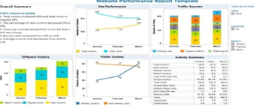
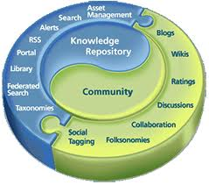






Mu Sigma recommended standardization of reports, tools across brands, flow of responsibilities; establishing a KM process
Marketing Operations and Reporting Automation (3/3)
Initiatives
Standardization and proper cataloguing across brands
Report template standardization
Technology platform standardization
Processes standardization
Establishing a thorough KM process
KM repository across brands
Communities on services like Yammer
Internal Wiki
Online request portals
Initiate internal wiki
KM library
Create Communities
Encourage collaboration
Standardization of flow of responsibility of request raise and execution of a report
Request generation by brand team
Update project request log by intermediary
Discussion among stakeholders followed by assigning responsibility
Work execution by analysts
Brand Team
Brand team requests a new project
Intermediary updates project log
Discussion among stakeholders
Work request execution and QC
Work product delivery
Intermediary team
Analysts

Slide 12
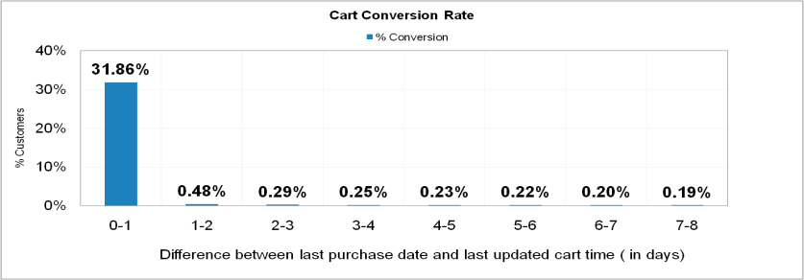
Cart Abandonment
Mu Sigma enabled a large retailer to increase revenue by 1.1% by improving re-activation strategy for abandoned carts
Background
Insights/Recommendations
32% of the shoppers convert their cart within 1 hour of last cart activity
An additional 1.5% shoppers convert within 4 days with a steep decline thereafter
The basket size for conversions from 24 to 48 hours is 30% higher than non-delayed conversions
The basket size shrinks by up to 60% on carts delayed by more than 48 hrs
Mu Sigma recommended sending 3 reminder emails after 1 hr -> 24 hrs -> 120 hrs
The client is one of the largest multi-channel retailers in the world and has a global presence in almost 14 countries
The online subsidiary is among the top 5 e-commerce players in US
More than 65% of the carts created are abandoned
The email team is currently sending a reminder email 5 days after the last cart activity
The client wants to determine the optimum period to send the reminder mails to maximize the response
Analytical Approach
The time taken by customers to convert their cart was computed as the difference in the last updated cart time and the next purchase made pertaining to the last updated cart time
The analysis was done across all months for customers who had subscribed emails as well as for customers who had unsubscribed emails during the time when they last updated their cart
The cart conversion rate was studied for first 8 days after the last updated cart date for a cohort of customers
Business Impact
The modified mailing strategy identified opportunity to increase revenue by 1.1%
Back

Slide 13
ASSORTMENT

Slide 14



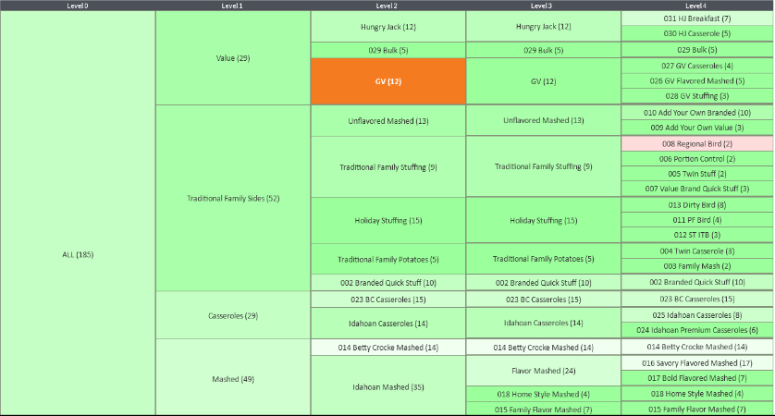
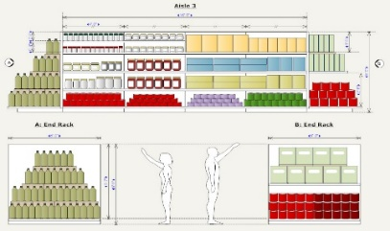

‘Hypermarket Assortment Planning’ will enable better decision making across business functions with a data-driven approach
Improvement in Overall sales Higher revenue and increased profitability by identifying opportunity gaps
Localised assortment catering to the customer needs and behavioural patterns across regions
Best- in class customer experience by right assortment decisions based customer decision trees
Inventory cost savings by insights based optimal product stocking
Common decision making language of assortment planning driven by ML/AI backed data intelligence
Streamlined processes as the tool will act as a stepping stone to space planning and planograms

Slide 15
Assortment Optimization aims at maximizing category sales and reach by optimal usage of the space available
Current State
Future State
The Assortment team has limited bandwidth to analyze data for assortment decisions
Outcome: Better Assortments meet customer needs and expectations
Buyers rely on heuristics to make changes in their category
Buyers and category managers follow a standardized approach to analyze categories and make assortment decisions
Products performance measurement and implications of adding/removing certain products is an unknown
Decisions can be made efficiently and data is accessed easily
The team is missing a standardized assortment process to gather data and make informed decisions quickly
Factors/considerations in adding/ removing products from a store are unknown

Slide 16
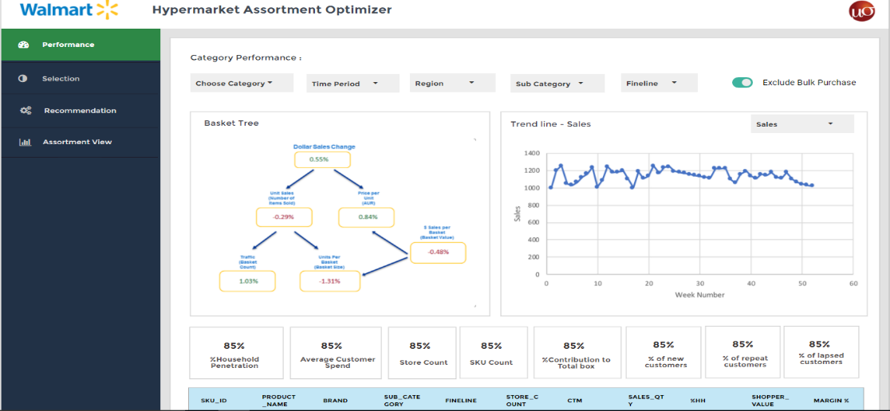
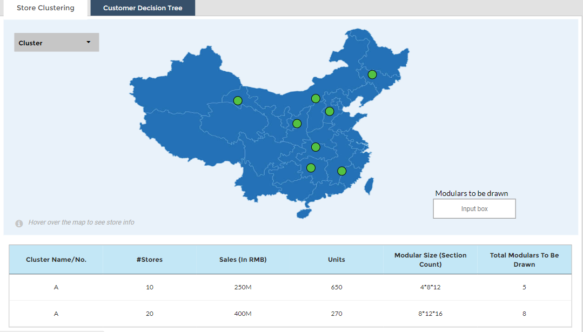
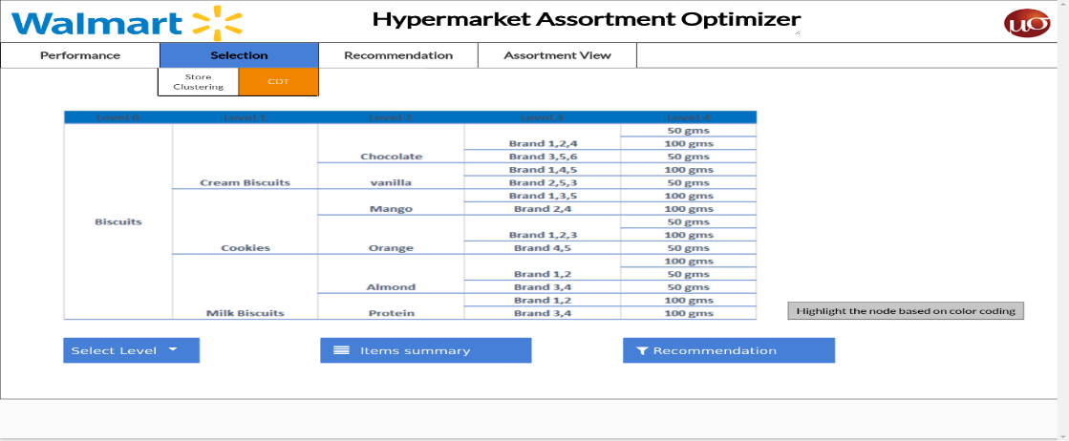
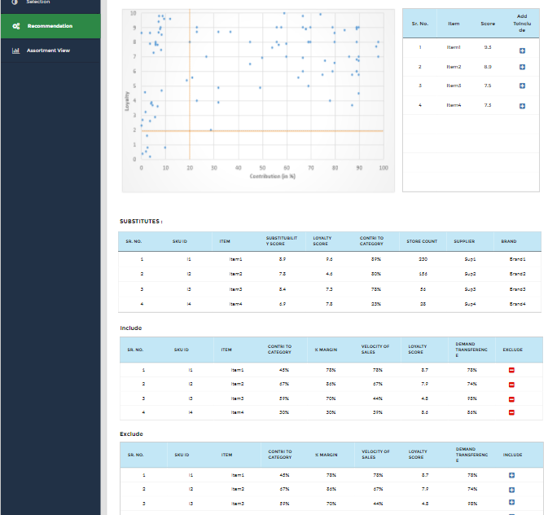
The final outcome will guide the user through all the steps of the process from data pulls to final assortment decisions
Category Performance
Store Clustering
Customer Decision Tree (CDT)
Loyalty & Substitution analysis

Slide 17
Walmart China leadership believes Assortment Intelligence has potential to increase margins by 111.13mn RMB by end of Year 2
 |  | 2017 Sales
4 Departments |  | 4760
4 Categories |  | 412.8
Total box |  | 55930
Based on prior Mu Sigma impact on Walmart projects
 |  |  |  | Year 1 |  | Year 2
4 Categories |  | Incremental Sales |  | 1.38 |  | 4.13
 |  | Margin |  | 0.3 |  | 0.8
Total box |  | Incremental Sales |  | 186.4 |  | 559
 |  | Margin |  | 37 |  | 111.13
Lift assumption of 1% YoY
on 2017 sales
Averaged across 542 categories
*NOTE: All figures in Million RMB
Walmart US assortment discipline team realized incremental sales worth USD 600mn within first 6 months of solution delivery
For China, estimation of 1% lift in all sales as a direct result of Assortment intelligence
Four Categories to realize incremental sales worth ~1.4mn RMB by end of 2018 and ~4.1mn RMB by end of 2019

Slide 18
LIFT

Slide 19
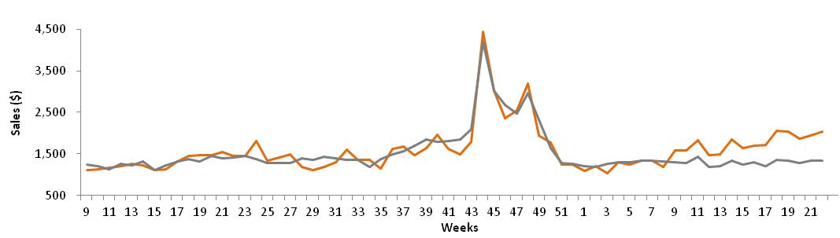
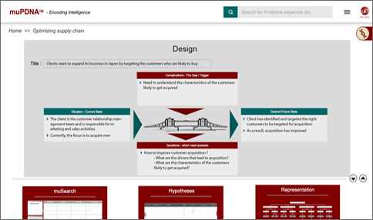
Enabled centralized analytics organization coordinate outcomes across various business stakeholders
Centralized analytics to drive value
Multiple business functions working in silos to
measure campaign effectiveness
Got stakeholders to collaborate and
align on outcomes
Developed single platform for end-to-end
LIFT reporting and scenario comparison
Marketing
Marketing
Event kick off
Campaign measurement
Test store
Control stores
Store operations
Assortment planning
Store operations
Assortment planning
Multiple levels of planning based on geographic,
time, and product portfolio
Identified all metrics to be planned,
created robust methodology
Developed single platform for end-to-end
LIFT reporting and scenario comparison
SMD
One-stop solution for end-to-end planning of all key retail metrics at all levels of geography, time, and product hierarchy
Plans used by the business to decide targets for each store
Optimized tool requires minimum manual intervention, while allowing for man-machine synergy
Sales
BMU
Shrink
Inventory
COGS
Online
BMD
IMU

Slide 20
Sales Impact Analysis tool helps make decision and measure 5000+ events on a yearly basis across various functions
Lift - Institutionalize a test & learn framework
Business Objective
Analytical Approach
THD experienced a fall in sales and hence aimed to achieve revenue growth per sq./ft. ft. by conducting various marketing, merchandizing and store ops. events across stores
A test & learn philosophy was recommended by conducting various tests and evaluate impact on sales
Mu Sigma built an automated merchant / marketing group facing Flex based tool to design & evaluate the impact of different tests & have one version of truth across the organization
With technological advancements in industry, Mu Sigma proposed, guided and collaborated with THD to move and rebuild the framework from SAS-Teradata to R-Hive-Hadoop environment
Design of experiments
Analyze event success history
Test store selection
Ensure presence of good control stores for selected test stores
Event rollout
Identify event rollout cadence
Event impact measurement & drilldown
Control store selection
Select order of events
Perform what-if analysis
Select number of test stores and events
Ensure representativeness of population
Measure impact
Identify top/bottom performing SKUs/Stores
Identify reasons for success failure
Rollout events across stores
Business Impact
$ Impact of any event is successfully measured for about 5000+ events
The merchants/ marketing group used these numbers to gauge effectiveness of events and choose the right combination of events and regions
Standard methodology used across the organization. This erases any doubts on the numbers given by any merchant
Post migration to R-Hive-Hadoop architecture from SAS-Teradata, Test and learn algorithm run time has reduced from 4 hours to ~1 to 10 minute for each event
Apart from merchandising and marketing events, LIFT tool has successfully measured the impact of major calamities across US

Slide 21
Mu Sigma implemented a Revenue Management System for remnant inventory allocation which resulted in a 20% lift in revenue
Inventory & Yield Management System
Business Case
Results
The client wanted to create a system for optimally allocating the inventory among advertisers and ad networks on a daily basis
Inventory volumes and network performance is highly volatile and needs to be forecasted with considerable accuracy
Past Impressions Data
Recent Performance Data
Impression
Forecasting
Model
Performance
Prediction
Model
R
M
S
Analytical Approach
DL4
Multiple forecasting techniques were used to forecast the available inventory for the day.
Adaptive Curve fitting techniques were used to model recent performance of each inventory category. This model was used for predicting monetization as a function of the impression volumes and characteristics.
Dynamic programming optimization techniques were employed to arrive at the optimum allocation of the available inventory across the advertiser pool.
An automated Revenue Management System (RMS) was developed to handle the above tasks on a daily basis.
Optimizer
Impressions forecast
Performance curves
DL3
DL2
DL1
Optimal Allocation
$5
$1
20% Higher Revenues
Implementation of RMS resulted in a revenue lift of 20% on the existing inventory and higher satisfaction for both advertisers and publishers.
Back

Slide 22


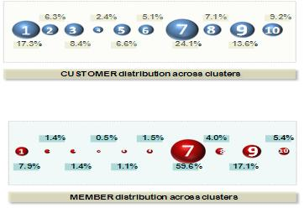

Conversion Model(1/2)
Mu Sigma helped a luxury retailer increase its conversion by predicting the set of brands a user is likely to purchase from
Background
Approach
Client is a high-end luxury retailer catering to an extremely fashion conscious and brand sensitive user base
It would like to increase the activation rates by presenting to its members sales from brands they are most likely to purchase from
Factors like demographics , visitation activity, email activity , etc. help in locating and predicting the brand in which a member is likely to convert
Brands were clustered into Brand Groups(BG) based on consolidation of purchase activity
Customers were assigned to a single primary cluster based on a normalized score of the units purchased in these clusters
Logistic regression models were built on the analytical dataset and validated to predict customer’s probability of purchase in a BG
New members were then scored according to these models and assigned to the cluster with the highest predicted probability
Observations & Validation
Brand Clustering
Scoring users
Brands were clustered into 10 different brand groups based on a clustering exercise
Distributions across Clusters
1
2
3

Slide 23
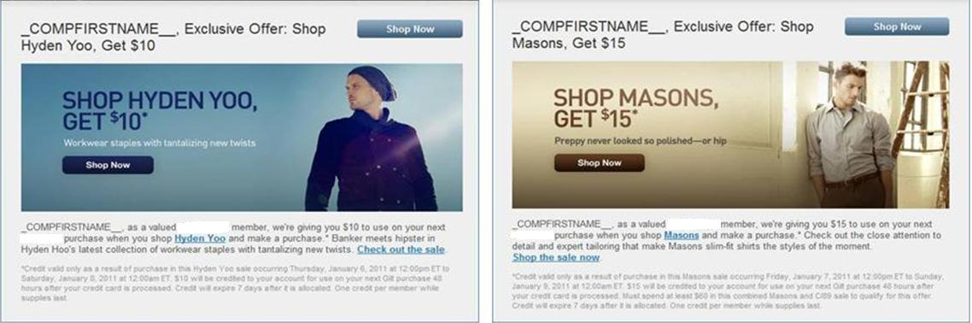
The output from these models was used to send out brand specific emails to all the non customers
Conversion Model(2/2)
Business Impact
Specific activation campaigns were designed in integration with the existing marketing calendar
Emails (similar to the ones shown above) were sent to members based on the cluster that they were assigned
Test & Control groups were designed to test the effectiveness of these campaigns
Client saw a 18% lift in new member conversion
Email open rate and visits to the website increased by an average of 10%.
Back

Slide 24
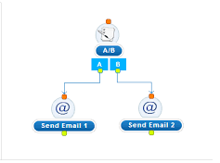
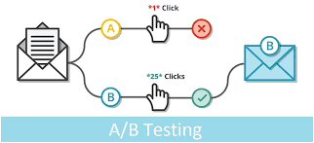
Enhancing the E-mail Marketing efforts using AB Testing improves customers’ experience through e-mails
Background
E-mail Marketing refers to sending e-mail messages with the purpose of enhancing a merchant's relationship with current or previous customers, encouraging customer loyalty and repeat business, acquiring new customers or convincing current customers to purchase something immediately, and sharing third-party ads, etc.
A/B Testing is a scientific method to prove the causality of a change on the observed impact. In other words, using A/B testing we can be sure that the observed impact is caused by the change we made and not simply due to correlation
AB Testing in E-mail Marketing plays an important role in understanding and enhancing the customer’s response through e-mails
Regular e-mail is modified to create a second (updated with only one change) version of the same email
Statistical analysis is used to determine which variation performs better for a given conversion goal

Slide 25



A logical approach to validate the change to be introduced in the emails, results in increased engagement and productivity
Logical Approach
Collect Data: Look for the e-mail part with lower engagement and productivity that can be improved
Identify Goals: It can be anything from clicking on the email or link to product purchases and e-mail sign ups
Create Variations: This might be changing the color of a button, swapping the order of elements on the email or hiding navigation elements, etc.
Run Experiment: Email recipient will be randomly assigned to either the Control or Test groups
Analyze Results: Recipient interaction with each experience is measured, counted, and statistically compared to determine how each performs
Use Case - Test details
Objective – A triggered e-mail program is run by a fortune 500 organization, under which it sends out personalized e-mails to the customers based on their online behavior on the website
Target – Business wants to enhance the customer experience in turn increasing engagement and productivity of the e-mail program
Timing – Daily Trigger
KPI – Engagement (Click rate) and Revenue ($/EM)
E-mail Qualifiers
Group A (Test Population)
Group B (Control Population)

Slide 26
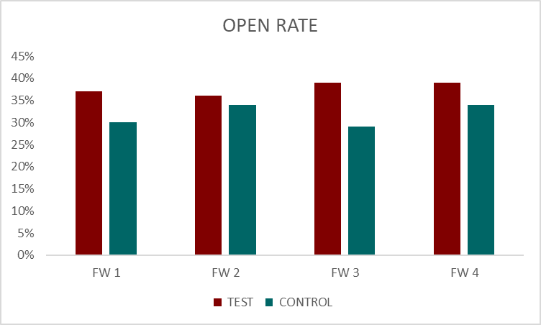
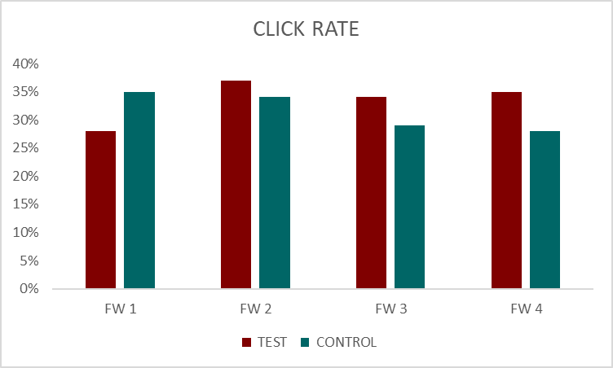
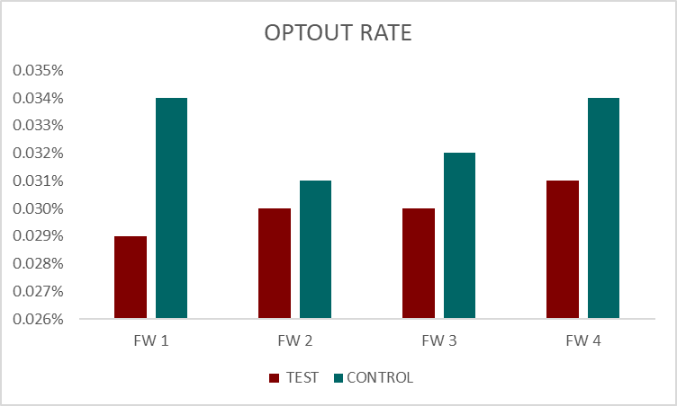
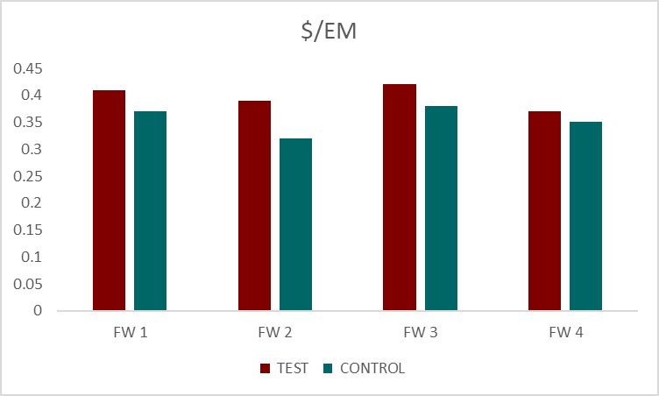
A-B Test results shows that the change/efforts made (Test population) has a positive effect on Engagement and Revenue KPIs
Findings
In terms of the Engagement Derived Metrics, Open Rate and Click Rate has a positive lifts of ~15% and ~20% respectively (across the time period for which the test was carried out)
Optout Rate has a positive lift of ~10% (decreased) for the Test E-mail against the Control E-mail
We also observed that the ROI on every e-mail sent has increased by ~10% for the Test Creative

Slide 27
An appropriate approach to test and roll out the changes in existing emails enhances the customer experience and ROI
Recommendations
As the Click Rate and ROI gain of the Test population was higher in comparison to the Control, Test version won over the Control version
On rolling out the newer version to the whole population there will be an increase in the Engagement by ~12% and Productivity by ~10%, hence we should go ahead and accommodate the changes
Business Impact
On rolling out the new version, the program Engagement (Click Rate) increased by ~10%
ROI gain was ~14%
Strategic Initiative & Planning
Execution
Monitor and Evaluate

Slide 28

An E2E Store planning tool that runs optimization algorithm generates half yearly plans for 1979 stores on 11 metrics
Store Planning
Business Objective
Analytical Approach
The FP&A receives core level plans for each of the classes from Division Finance team every fiscal half
The FP&A team has to plan at a Store level for each of the classes based on this core level plans
With multiple retail parameters involved in planning for each of the Home Depot stores in the continental US, Mu Sigma streamlined the process to execute planning in a time bound and efficient manner
.
Historicals- LY/LYLY
Metrics Planned:
Sales
Store Markdowns
Buyer Markdowns
Buyer Markups
Shrink
Inventory and Receipts
Initial Markups
COGS-A
Dotcom Sales
Dotcom Daily
Daily Sales
Inputs
Core Class Plan
Store List
Class List
Manual Plans
Business Impact
The methodology generates plans for all the retail metrics for each of the stores within the continental US for all the classes
The Store Class level plans are used by business to decide on the half yearly targets for each store based on the company’s targets and historical numbers
The Store Planning tool is optimized to handle all the processes with minimum manual work and also a smart backtracking system to precisely identify errors to further reduce turnaround time
Business Guardrails
Stores Planned | ~1979
Classes Planned | ~324
Metrics Planned | 11
Store Class Week Outputs
Receipts Calculations:
Retail Receipts=Sales+EIR-BIR+SMD+BMD-BMU+Shrink
Cost Receipts=(1-IMU%)*(Retail Receipts)

Slide 29
Near real time customer targeting through next purchase propensity models enabled a 49% lift in email productivity
Shopper Browser
Business Objective
Analytical Approach
The marketing team used to send generic emails to the population without taking into account the purchase trends
Their browsing behavior was not leveraged, which ended up in the customers receiving static push content, resulting in low engagement
Mu Sigma team helped THD to recommend categories based on recent purchase and browsing trends and to ensure that users received appropriate content
.
Variables Used
Model to provide 5 category & class recommendations
Predictive logistic models based on propensity score and decile distribution
Purchase
behavior
Browsing History
My List, MAM
Bazaar Voice
Demographics
PLCC, Quote Data
Logic Building
Scoring & Output
Beta values from model
to calculate purchase propensity
Demi deciling
Lift for deciles
Top 5 category and class recommendations
Business Impact
Framework to evaluate Creative Design, Model Performance, Targeting Frequency etc.
The recommendations led to an increase in the revenue generated and an improved email engagement
The Store Class level plans are used by business to decide on the half yearly targets for each store based on the company’s targets and historical numbers
Test & Control
Recommendations based on preference
Top 5 categories in Hero and Pods of Creative
Side rail includes list of broad range of products
Email Engagement – Click Rate | 12% lift
Revenue | 49% lift
Recommendations

Slide 30
Welcome Series Analysis
Mu Sigma recommended a 3 Phase testing framework for CRM Pro team to increase the engagement of New Joinees
Business Objective
Output Sample
CRM Pro sends a welcome email to new joinees after initial sign up, and then enrolls them in a 7-week long series to transition them into active regular members
The welcome series consists of three touches with coupons but business believes these coupons might not be optimal for engaging new members
Business wanted us to analyze the performance of the current welcome series and provide recommendations for coupon depth, frequency and series length to maximize engagement
Two offers were given in a single coupon, one with high threshold and other with low threshold in Phase 1
A shorter series period to be tested against the regular length in Phase 2 with feedback from Phase 1
Increasing frequency of coupons to maximize redemption in Phase 3 with length and offers from earlier phases
Analytical Approach
Business Impact
A structured approach was applied where most of the factors which could affect the coupon performance were listed down
A list of hypotheses was built based on targeting depth, frequency and length of series. Multiple EDA’s were done to attribute engagement, sales metrics and coupon effectiveness
Optimum offers to target both redeemers and non-redeemers were identified by performing a drill down analysis of Average Order Gap (AOG) and Average Order Value (AOV)
A 3 Phase framework was recommended to test coupon depth, series length and coupon frequency in order to maximize engagement
Primary business impacts expected from the plan:
Increase Opens, Downloads, Clicks (Engagement)
Decrease opt outs and increase coupon redemption
Maximize sales by targeting generally redeeming as well as non-redeeming population

Slide 31
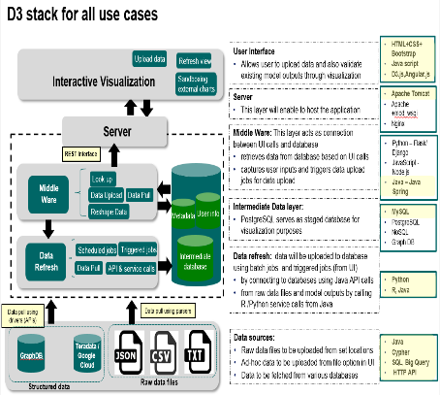
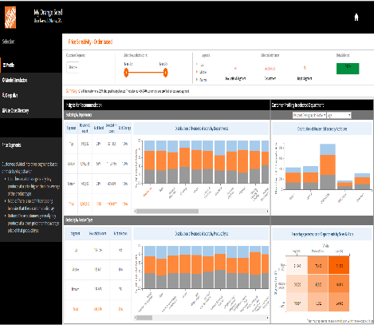
THD Online
A visualization portal was created to help THD Online team make effective decisions on customer's price sensitivity
Business Objective
Output Sample
Home Depot is keen on improving online business by improving customer’s experience on the website
The clients wanted to develop a visualization application to simplify insight generation from the output of their online business models
A web-based decision-board was needed for visualization of the model-outputs that can be leveraged by the stakeholders
D3 stack image and a view from the web-tool
Analytical Approach
Business Impact
Based on the understanding of the size of data & robustness of the portal required, etc. the D3-stack was finalized to develop the web based tool
One particular model based on priority, called ‘Price-sensitivity’ was considered while developing use cases based on the end user’s need from the portal
The graphs required to best explain the use cases were finalized and the mock-up view of the tool was confirmed
The web based application was then developed as per the finalized D3 stack and mock-up view
The use cases will help end-users of the portal better understand the customer’s price sensitivity related behavior which will help them in:
- making effective marketing strategy
- customize user’s experience on PLP/search bar
- dynamic pricing of online products etc.
Different model-outputs available with the Online team can be easily integrated with the tool to create a one-stop decision-platform consisting of inter-connected visualizations

